Slide 1
Kurzweil 3000 Trainings Session 1: Intro to Kurzweil
Office of Student Accessibility services

Slide 2
Overview
Installing Kurzweil 3000 on your Mac of PC
Opening Kurzweil 3000 on your Mac or PC
Accessing your textbooks using your Google Drive Shared Folder
Accessing your textbooks using Bookshare
Reading your textbooks
Accessing personal PDFs

Slide 3
Installing K3000
To install Kurzweil 3000 on your PC or Mac you will need to:
www.kurzweiledu.com/k3mac for Mac
www.kurzweiledu.com/k3win for PC
When on the page, you will want to select the option labeled “Version 16 Subscription (Weblicenses)
Download will take about 20-40 mins depending on internet speed
Open the downloaded .exe file and follow the on-screen instructions
Kurzweil 3000 can also be utilized through the www.kurzweiledu.com website
Your login is the same for the website as it is for the desktop version

Slide 4
Opening K3000
After the installation is completed you will need to open the Kurzweil 3000 file by selecting the icon
When started, you will be prompted to enter your login credentials. These have been emailed to you by the AT Staff (osasAT@usc.edu)
Email subject is “AT Profile Creation”

Slide 5
Time to hit the ‘books
Locate the “File” tab in the menu bar (Mac) or the Open Folder button (PC)
For Mac, you will want to Scroll to the option “Open from Google Drive”
For PC, you will select the option that looks like the Google Drive icon labeled “Open from Google Drive”
For Website, you will find a button that is labeled “Google Drive”
Log in to your Google Drive account using your USC email and password
Select the option in the on-screen list for “Shared with Me”
Locate the folder with your name on it (example 1. Jordan Colbert)
Select the textbook you wish to read
Open either the PDF or the KESI if available
There is no difference between the files. KESI are just PDFs that have been opened and saved by the K3000 user. They cannot be opened by any other software.

Slide 6
Using Bookshare with K3000
For Mac
For PC
Locate the “Online” tab in the menu bar
You will need to select “Change User” first to enter your Bookshare login.
Enter the textbook information
Select the appropriate textbook and the option “Open after Downloading”
Save the book to your computer for quicker access
Locate the “Online” tab in the menu bar
You will need to enter the textbook information
Only select the two “Bookshare.org” options before entering your login
Save the book to your computer for quicker access

Slide 7
Reading using K3000
When you have opened a file, click an area of the page where you would like the program to start reading
Press the “Play” button located in the toolbar
The audio settings can be adjusted by selecting the tab “Audio Options”
Change the rate of reading
Change the voice
Change the highlighting method
Change the reading unit
To jump to the next reading unit, press the “Forward” button in the toolbar
To jump to the previous reading unit, press the “Backwards” button in the toolbar
To Bookmark the page, select the “Bookmark” button in the toolbar
This allows for quickly jumping between important areas of the book

Slide 8
Personal Usage
Kurzweil 3000 can also be used on any PDF, DOCX, EPUB, or RTF file that you may already have on your computer.
To have Kurzweil read files from your computer you will need to:
Open K3000 from desktop or on the website
Locate File in the menu bar and select the “Open” option
If more than one page , you will be prompted to select the range of pages you’d like to be recognized by K3000
Enjoy!

Slide 9
For More Information
Kurzweil 3000- www.kurzweiledu.com
Tutorials available at the Kurzweil Academy https://www.kurzweiledu.com/kurzweil-academy/kurzweil-academy.html
Bookshare- www.Bookshare.org
Google Drive- https://support.google.com/drive/?hl=en#topic=14940

Slide 10
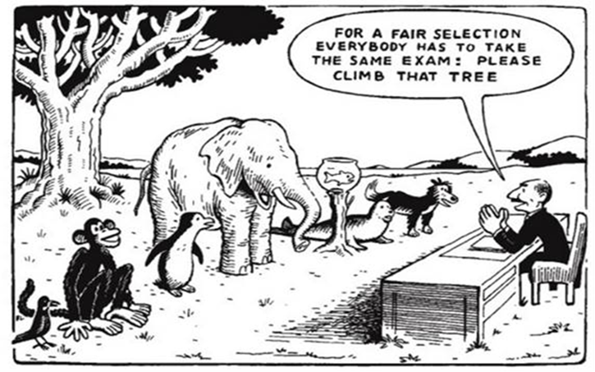
Contact us
Office of Student Accessibility Services
Grace Ford Salvatori Hall (GFS)
3601 Watt Way, Suite 120
Los Angeles, CA 90089-0896
Office: (213) 740-0776
http://osas.usc.edu
Office Hours: M-F 8:30am-5pm

